Slide 1
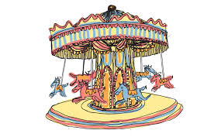
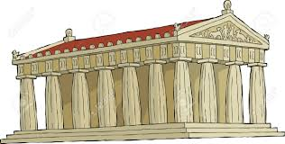
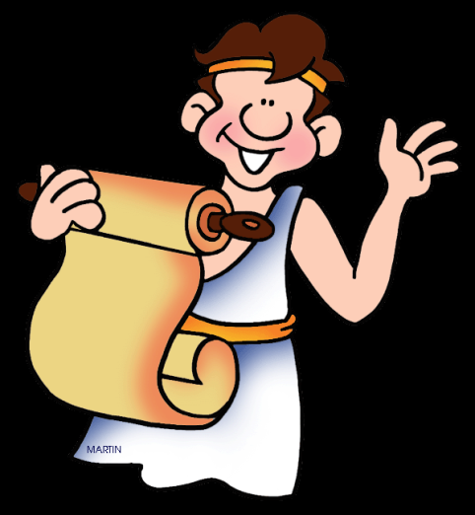
Poly-Go-Round
The Polis Of the Greeks (a show)
Parthenon
All Natural Gift Shop
Olive Tree Grove Menu
Olive Tree Grove Restaurant

